Slide 1



CS616- Human Centered Computing
Project II
Recommender System
Presented by- Group AAV

Slide 2
Aim of the Project
Problem Statement: On a given dataset, our task was to apply various recommender algorithms for movie recommendations.
Towards formulating Recommender system, it was pre-requisite to preprocess the dataset in a way that can be later processed by our recommender system logic in program.

Slide 3
Solution Methodology
Our project involved a comprehensive methodology that aimed for movie recommendations. We attempted to formulate different Recommender systems viz. Content based, Profile based(Collaborative filtering) and Hybrid Recommender system.
Data Preprocessing
Data Reading: The code starts by opening two essential data files, "u.data" and "u.item," containing movie ratings and details.
Selection of Key Data: Important data like "movie id," "movie title," "UserID," and "Rating" is chosen for analysis.
Data Cleaning: Unnecessary elements, like the "Timestamp" column, are removed for simplicity.
Genre Insights: Detailed movie information, including genres, is extracted and organized, enabling a deeper understanding of movie content.

Slide 4
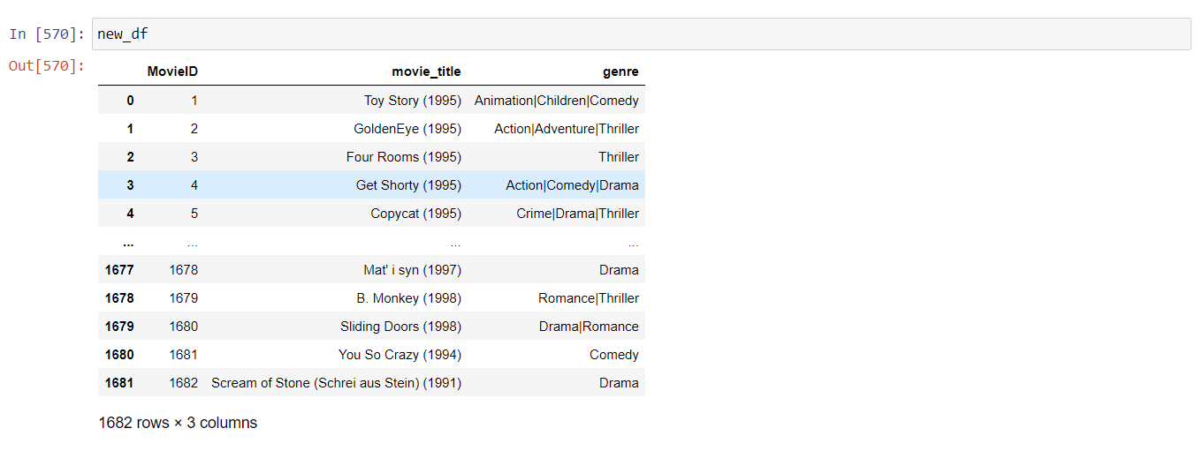
We have new Data-Frame after data preprocessing

Slide 5
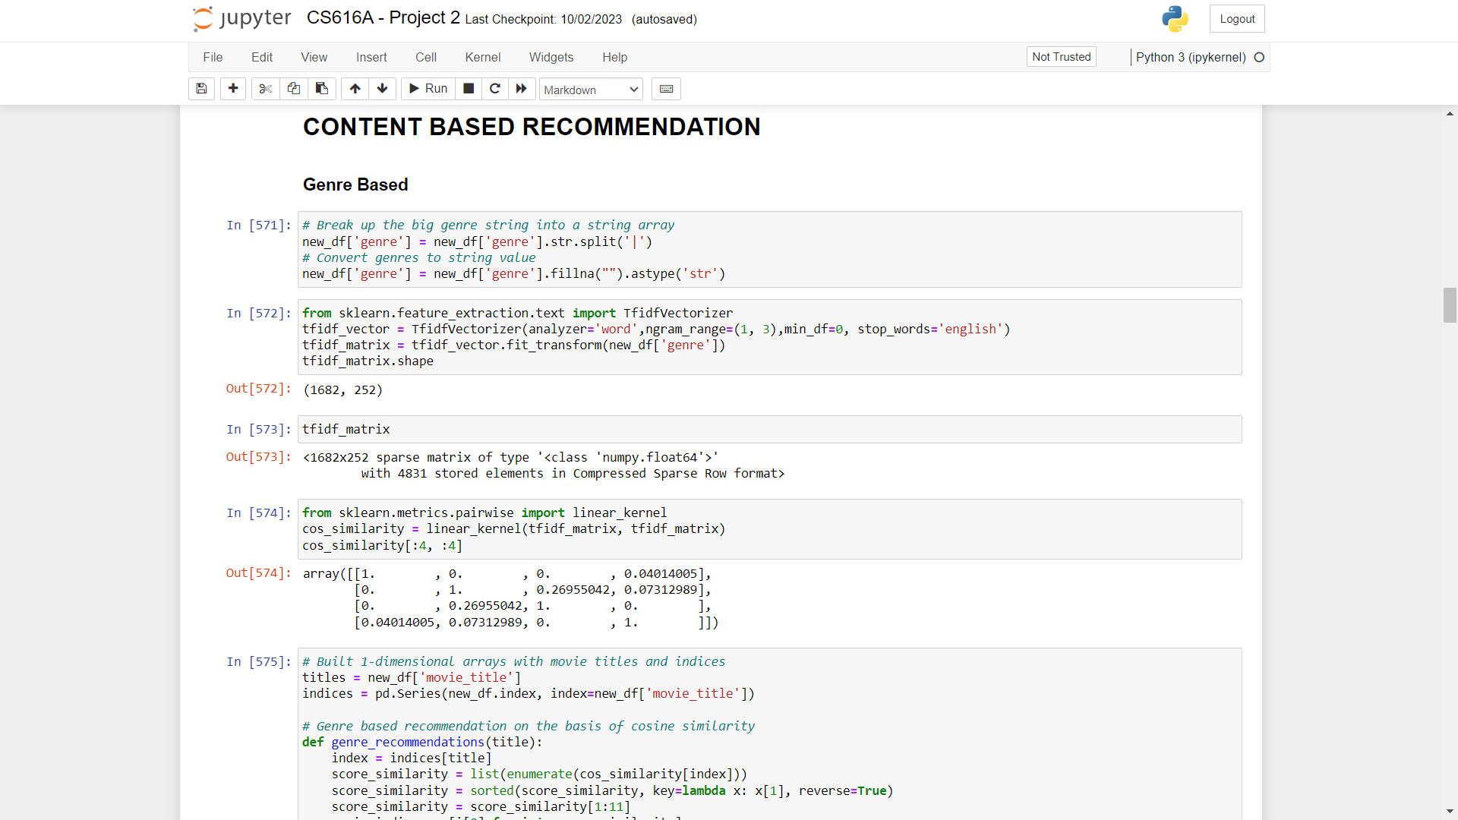
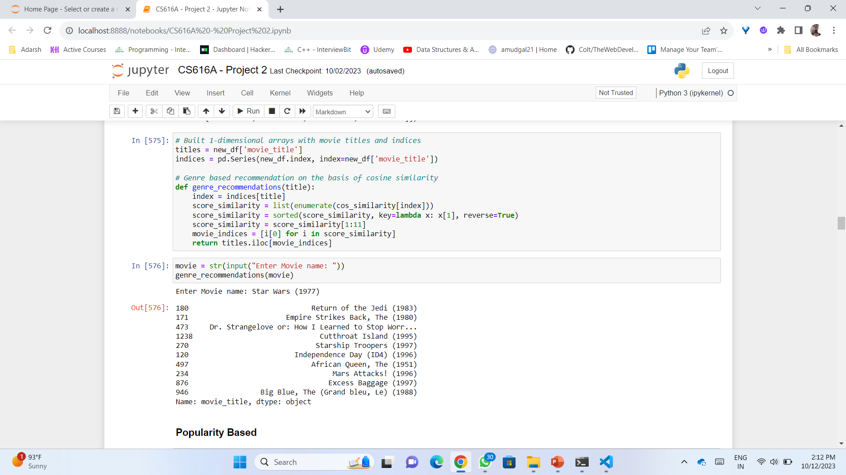
1. Content based Recommender system
Genre Based

Slide 6
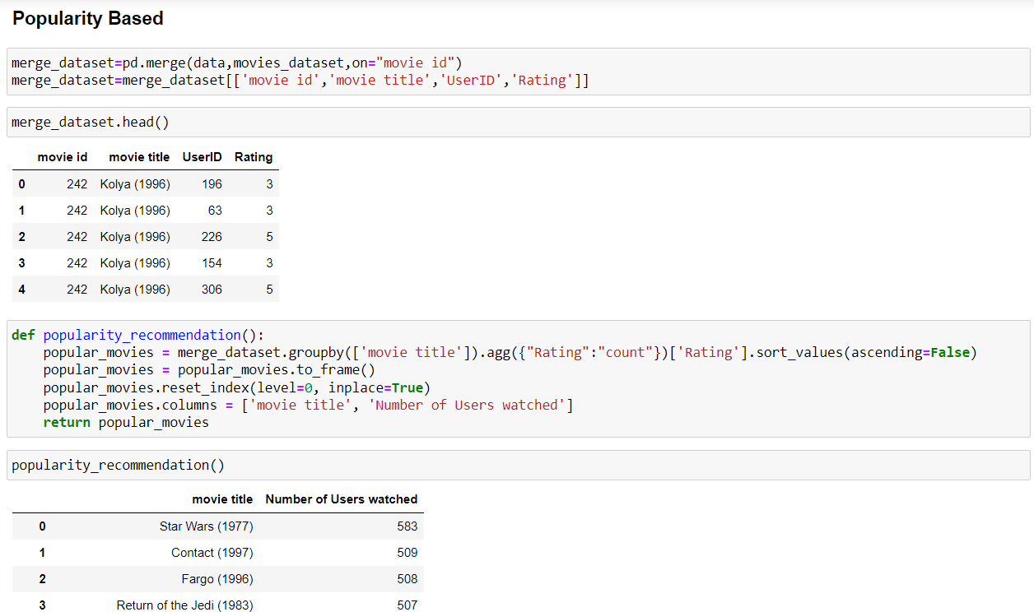
Popularity Based

Slide 7
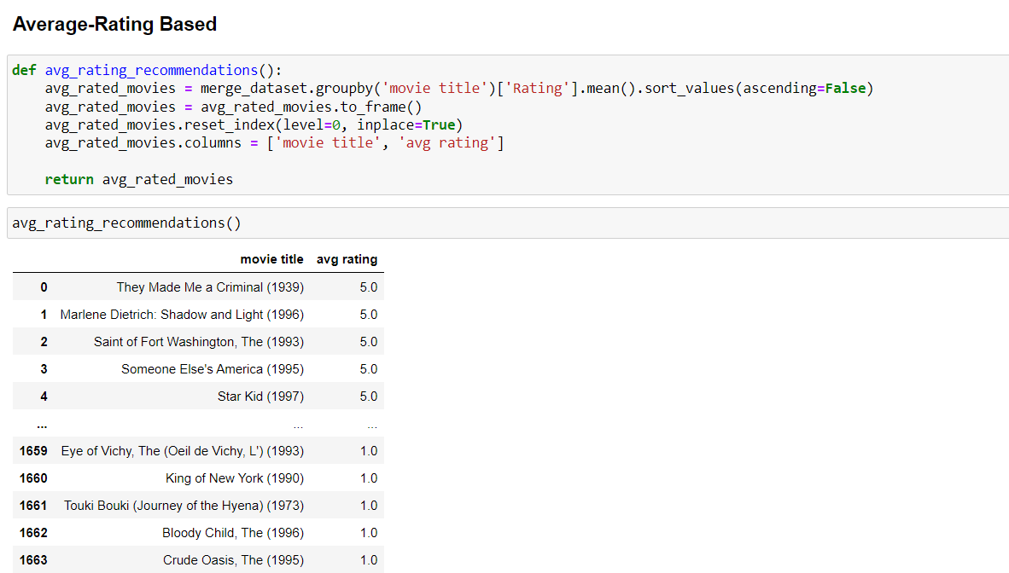
Average-Rating Based

Slide 8
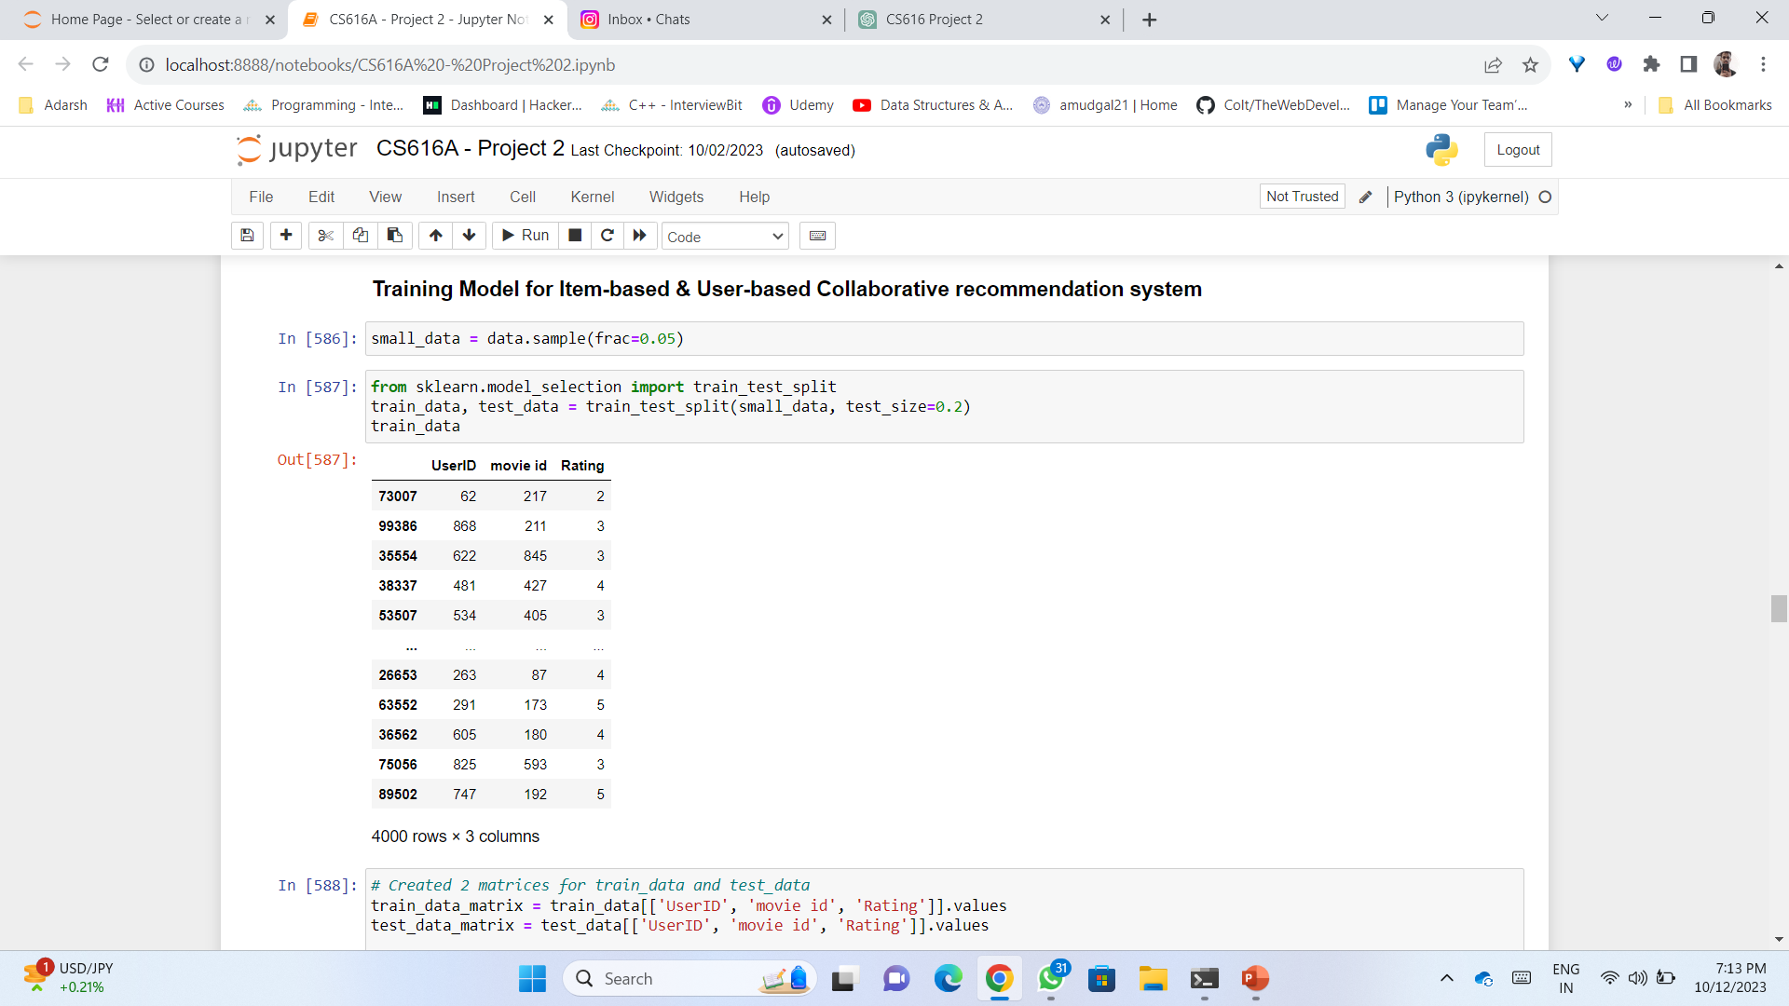
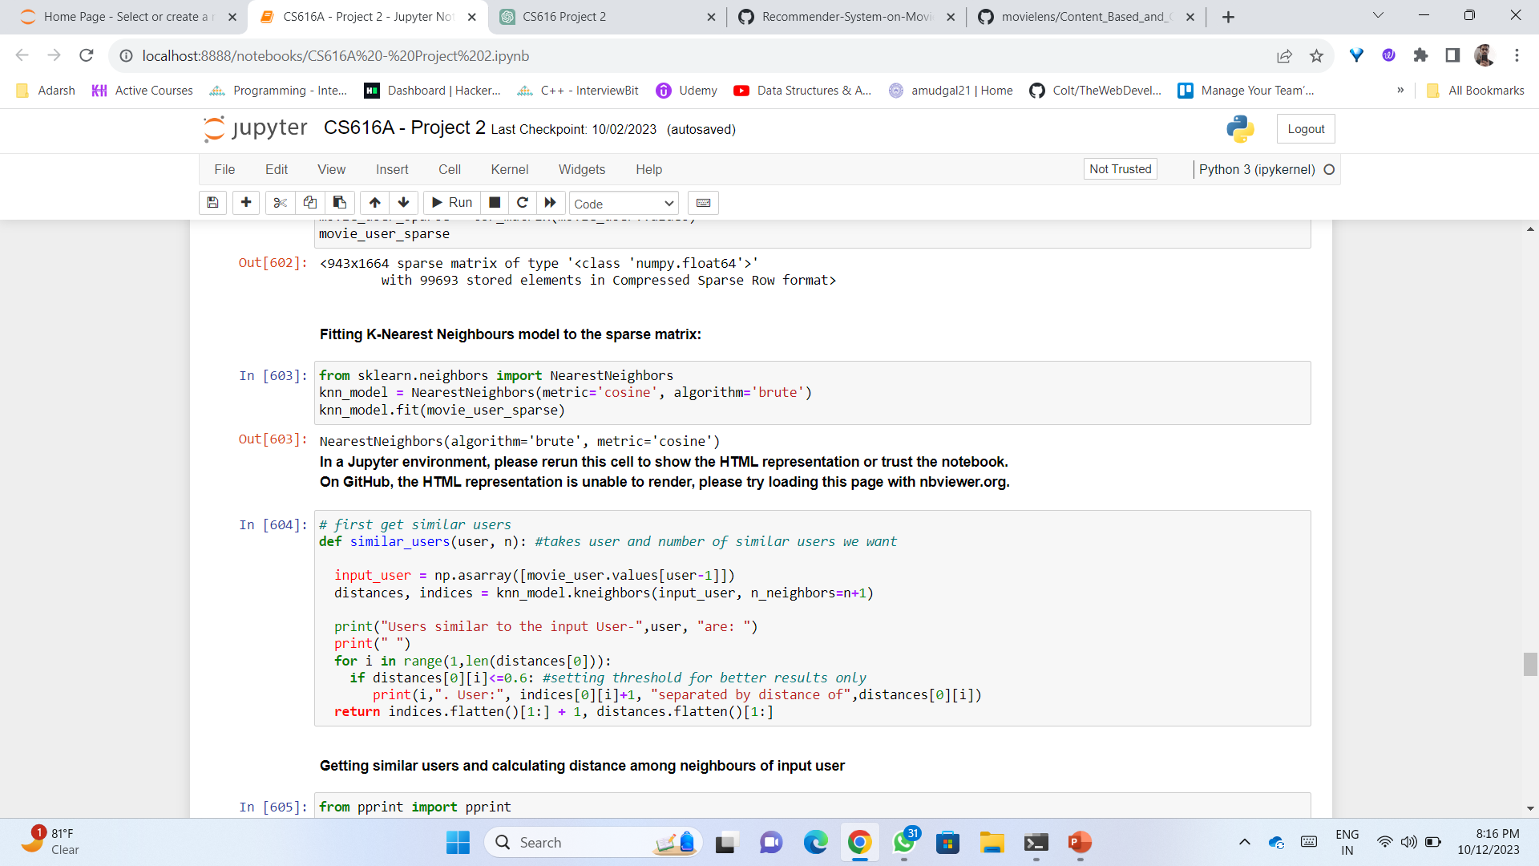
2. Profile based Recommender system
In this recommender system we tried 2 types of algorithm:
Training Model by splitting data in train and test dataset
Training KNN Model

Slide 9
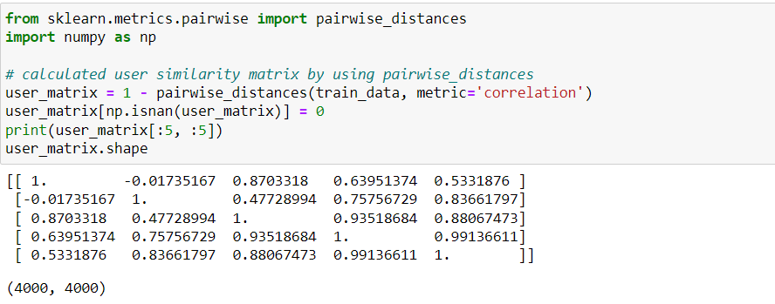
Training Model by splitting Dataset for
User & Item- Based Collaborative filtering
After splitting the data into train and test data set, we made 2 matrices with ‘UserID’ , ‘movie id’ , ‘Rating’ for both dataset.
We find user similarity matrix by finding correlation-based similarity between each vector using pairwise distances

Slide 10
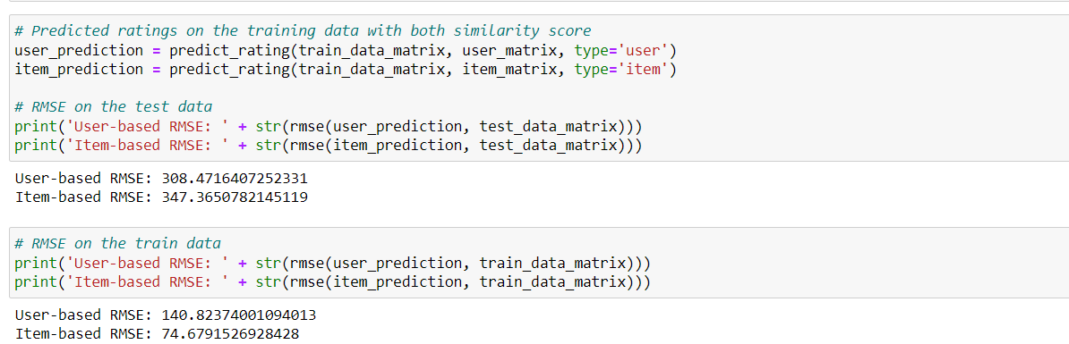
Training Model by splitting Dataset for
User & Item- Based Collaborative filtering
Similarly find item similarity matrix by using transpose of train data matrix while finding
correlation-based similarity
Then we define predict function to find error in prediction
It looks like Collaborative Filtering model suffers from overfitting problem as we only train it on a small sample dataset (5% of the actual 10k ratings).
So, to resolve this issue we used KNN model as in this approach similarities are calculated based on an unsupervised learning model, rather than Correlation-based similarity

Slide 11
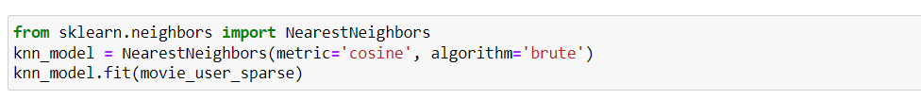
Training KNN Model for
Item-Based Collaborative filtering
Created a new dataset by merging user and item dataset on common column ‘movie id’
Refined dataset by grouping “UserID”, “movie title”, and “rating”(mean).
A dataframe (movie_user) made which is matrix where rows represent users, columns represent movie titles, and the values represent the ratings given by users to those movies
Converted the movie_user rating matrix into a user-movie sparse matrix, for optimizing memory usage.
Trained KNN model with a cosine distance metric for item-based collaborative filtering.

Slide 12
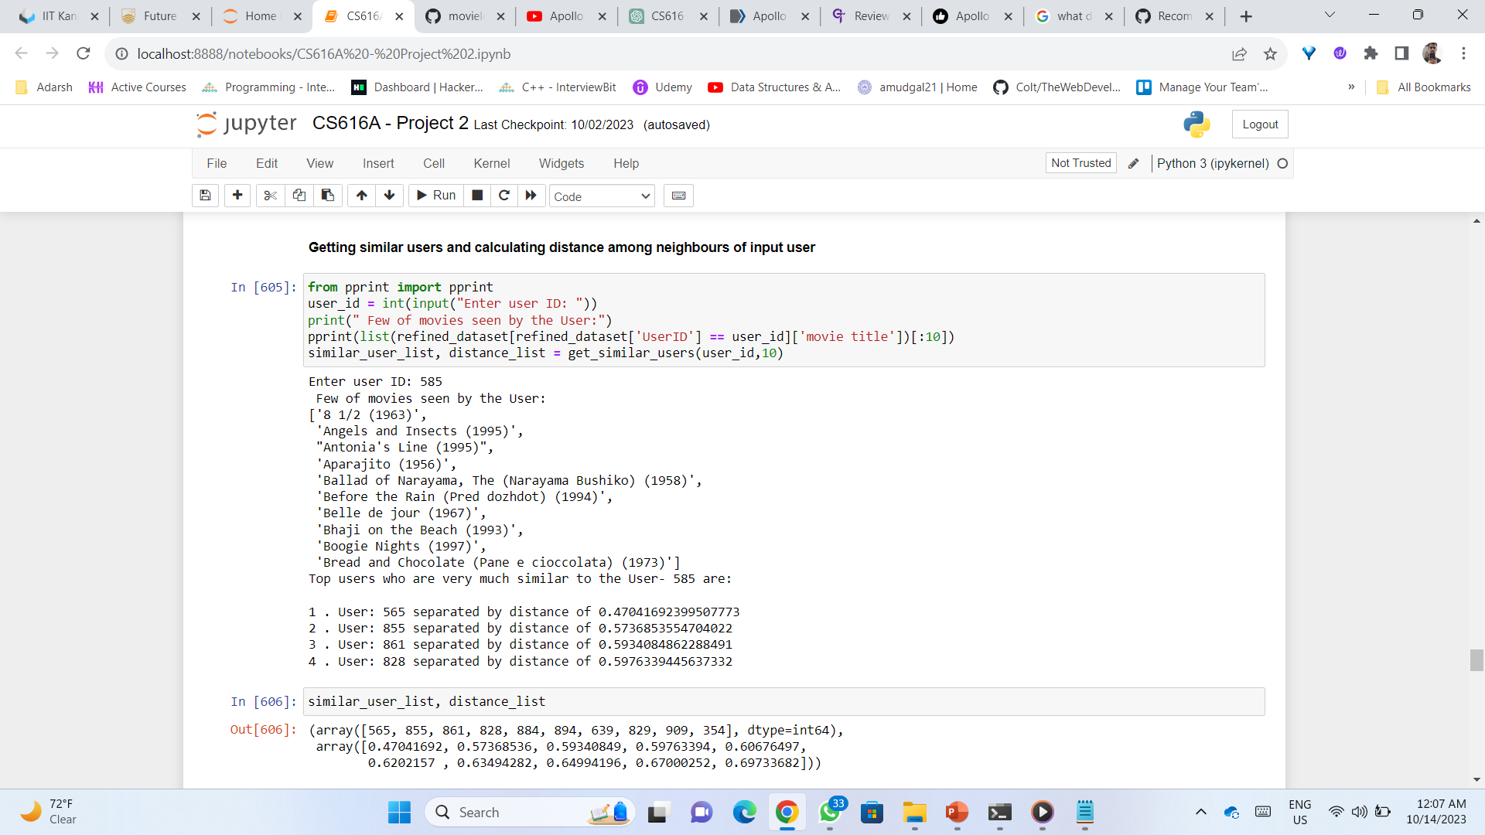
Training KNN Model for
Item-Based Collaborative filtering
Implemented a function to identify users similar to a given user based on their ratings, using
the KNN model.

Slide 13
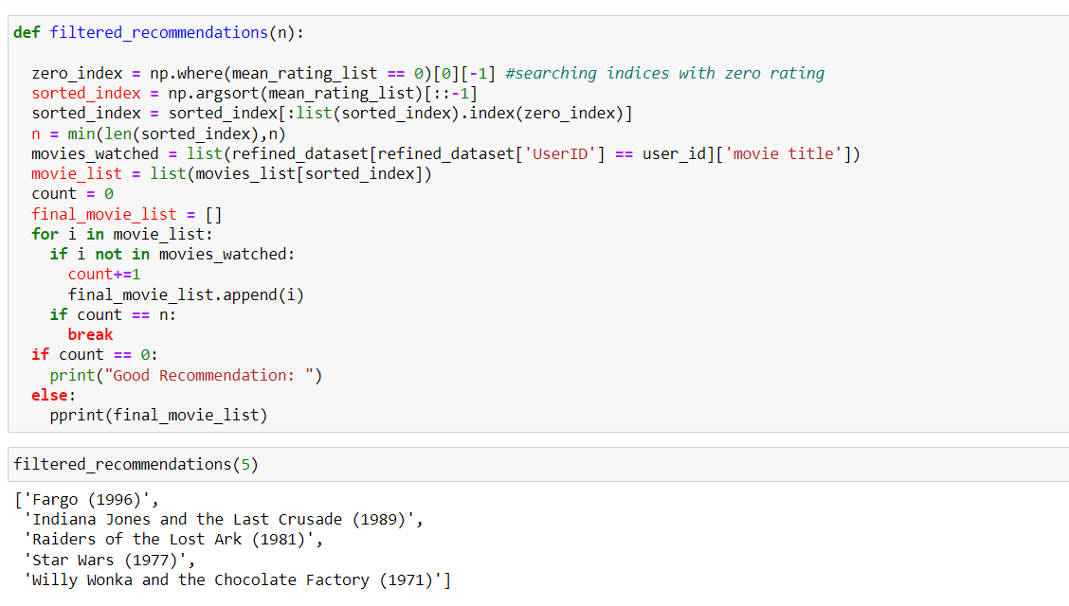
Developed a filtered_recommendation function that suggests movies highly rated by similar users,
filtering out movies the target user has already seen or never seen by similar user
Training KNN Model for
Item-Based Collaborative filtering

Slide 14
3. Hybrid Content-Based Recommender system
Our Hybrid Recommendation System combines various recommendation approaches, offering genre-based, popularity-based, and average rating-based movie suggestions in one system.
We assign different weights to these methods based on user preferences, making the system more effective and personalized.
By blending these methods, we enhance movie diversity, ensuring a satisfying experience for users with different tastes.
Users receive movie suggestions that match their preferences while also discovering new and popular options.

Slide 15
Key Takeaways & Conclusion
The various recommendation methods, like Content-Based, User-Based Collaborative Filtering, Item-Based Collaborative Filtering, and a Hybrid Approach, give a wide range of movie recommendations.
Users receive personalized movie suggestions based on their unique tastes, making their movie-watching experience more enjoyable.
The code evaluates how well the recommendations match user preferences using Root Mean Square Error (RMSE), and suggest to use a better recommendation system
For large dataset KNN model is better for recommendation as it take whole dataset into account.
The hybrid recommendation system combines different Content-Based recommendation systems which allows to get a better recommendation.

Slide 16
Thank
You

